Slide 1
CSE 3666 Demo of Multiplication
Created by: Prof. Caiwen Ding at UConn

Slide 2
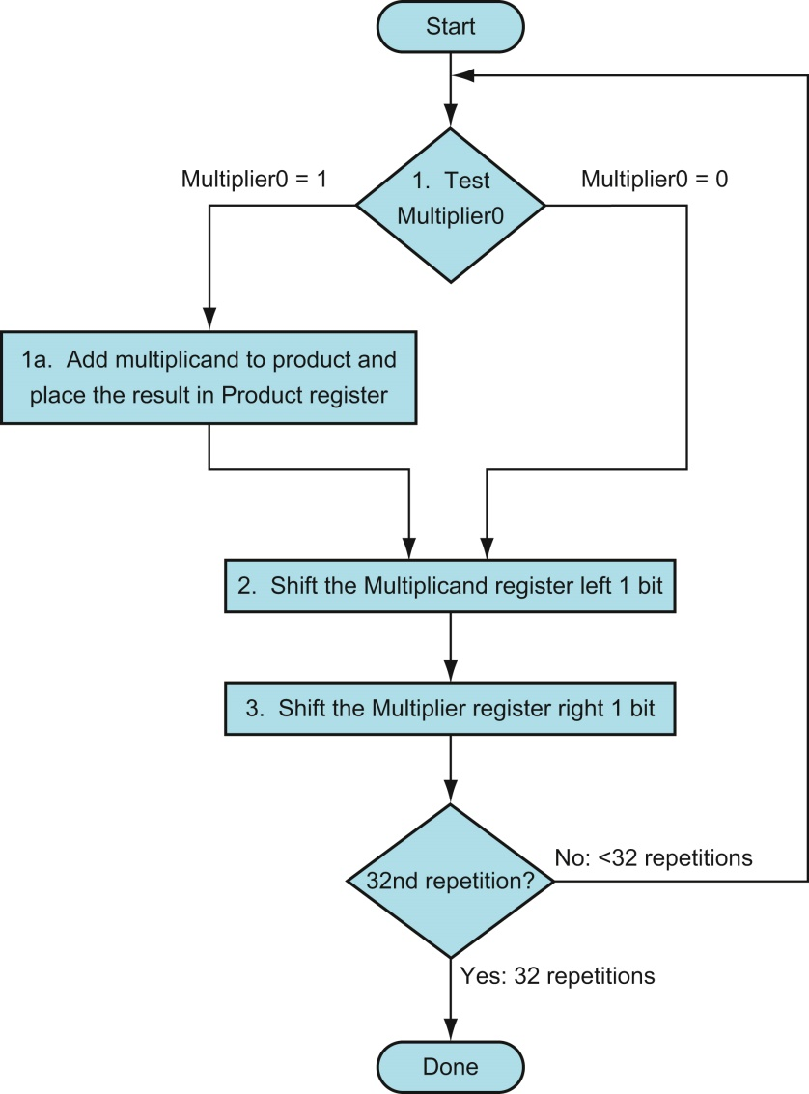
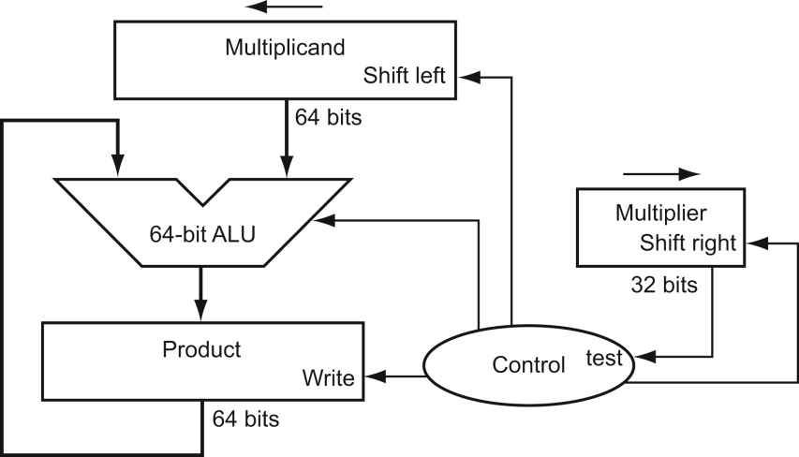
Multiplication Hardware for 4 bits
multiplicand
1000
× 0101
1011
0000
1011
0000
0110111
multiplier
product
update?
Initially 0

Slide 3
CC0->CC1
multiplicand
1011
× 0101
1011
0000
1011
0000
0110111
multiplier
Shift
0001 0110
0000 1011
0010
0101
product
0000 1011
0000 1011
0000 0000
update?
Initially 0

Slide 4
CC1-> CC2
multiplicand
1011
× 0101
1011
0000
1011
0000
0110111
multiplier
0010 1100
Shift
0001 0110
0000 1011
0001
0010
0000 1011
0101
product
X
0010 1001
0000 1011
update?

Slide 5
CC2->CC3
multiplicand
0101 1000
1011
× 0101
1011
0000
1011
0000
0110111
multiplier
0010 1100
Shift
0001 0110
0000 1011
0000
0001
0010
0000 1011
0101
product
0011 0111
0011 0111
update?

Slide 6
CC3->CC4
multiplicand
1011 0000
1011
× 0101
1011
0000
1011
0000
0110111
0101 1000
Shift
multiplier
0010 1100
0001 0110
0000
0000 1011
0000
0001
0010
0011 0111
0101
product
X
1000 1111
0011 0111
update?

